Slide 1
GVSETS 2026 | Digital Engineering / Systems Engineering Technical Session | Novi, Michigan
An AI‑Ready Decision Digital Thread (DDT) Schema for Digital Engineering
From evidence to commitment: Making concept decisions governable.
Ratna Babu Chinnam, PhD¹ · Alper Murat, PhD¹ · Satyendra Rana, PhD¹ · Stephen H. Rapp, PhD² · Joseph G. O’Bruba, PhD²
Michael McGregor Jr.³ · James E. Bechtel⁴ · Laura W. Costa⁵
¹Agile Systems LLC & DAOSoft Corp | ²USA T2COM, DEVCOM–GVSC | ³PAE Fires | ⁴PAE Maneuver Ground, PEO GCS | ⁵USA Maneuver FCD
DISTRIBUTION STATEMENT A. Approved for public release; distribution is unlimited. OPSEC#10865
Notes:
Defense: The title frames the paper as an evidence-to-commitment contribution rather than another generic AI/MBSE talk. The subtitle tells the audience why the work matters before the schema details appear.
Presenter cue: Open by naming the tension: DE has digitized many artifacts, but not the binding decision event. This talk supplies that missing layer.

Slide 2
Decision‑Centric Engineering & Acquisition
Storyline: Move from operational urgency → missing artifact → schema → governance mechanics → case proof.
2025
Agentic DI Framework
The Missing Contract
for Decisions
2026
Decision Digital Thread (DDT)
Agents can orchestrate planning and analysis…
…but a high-stakes program needs a governed object for “what was decided, why, and under what conditions.”
DDT becomes the AI‑ready system of record for evidence → commitment → execution → learning.
OUTLINE
1
Operational
need
2
Decision artifact
problem
3
DDT schema
contract
4
Governance
gates
5
BEV case
proof
Notes:
The 2025 work is positioned as the orchestration foundation; the 2026 contribution is the governed data contract that makes that orchestration safe and auditable.
Tell the audience this is not “another AI workflow deck.” It is the missing decision object that an AI-agentic DE ecosystem needs in order to be trusted.

Slide 3
The Army problem is now a decision‑cycle problem.
When design and engineering compress, bottleneck shifts from analysis capacity to governed commitment speed.
Product Development OODA loop
Warfighter pressure
Years
Months
Weeks / ≈2 months
legacy program cycles
compressed acquisition
current warfare tempo
• Long‑lead procurement
• Test acceleration risk
• Upgradeability / MOSA
DE/AI can improve the loop only if “decide” is governable.
• Cost and time to deploy
A faster OODA loop with undocumented rationale just accelerates accountability failures.
Notes:
OODA: (Observe, Orient, Decide, Act)
Defense: The talk starts with operational pressure because GVSETS is not an academic-only venue. The Army need in the paper grounds the schema in speed, risk, and modernization. The key defense is that DDT is not bureaucracy; it is a mechanism for making speed auditable.
Presenter cue: Use the OODA compression to make the audience feel the practical urgency. Then say: faster decisions need stronger governance, not weaker governance.

Slide 4
The Gap: Digital threads trace what, but not why.
Requirements, architectures, and verification artifacts are increasingly connected; concept commitments are still scattered across slide decks, minutes, and mutable model links.
Product thread state
Audit questions
programs struggle to answer
Requirements
Architecture
Verification
• Which dataset justified the recommendation?
what we built
what we modeled
what we verified
• Which model baseline was used?
Decision state
• Were bias checks completed before the gate?
meeting minutes
trade study v7
model URL
approval email
WHY?
• What conditions made the approval binding?
slide rationale
assumption note
risk spreadsheet
Notes:
Defense: This slide creates the central pain point. It separates the mature part of DE traceability from the weak part: concept decision rationale and commitment governance. The content is intentionally framed as audit questions because that resonates with government, program, and engineering stakeholders.
Presenter cue: Pause on the word “why.” The audience should leave this slide thinking: yes, our digital thread does not really answer that.

Slide 5
A decision artifact is the control‑plane of the digital thread.
It is not an analysis model and not a folder of supporting documents; it is the minimal machine‑interpretable record that makes a commitment governable.
Question
& scope
Objectives
& constraints
Reviewed
evidence
Decision
Artifact
Binding
Commitment
Alternatives
/ option set
Uncertainty
& risk
Approvals
& conditions
DDT is authoritative for decision governance state and provenance; MBSE/PLM remain authoritative for product definition and verification artifacts.
Notes:
Defense: The slide defines the construct cleanly, so the audience does not confuse DDT with an optimization model, SysML extension, or document repository. The control-plane metaphor is defensible because DDT governs transitions, approvals, provenance, and conditions while referencing engineering artifacts in their native systems.
Presenter cue: Say: this is the smallest record that lets a program answer “what did we commit to, on what evidence, by whom, and under what stop rules?”

Slide 6
Fifteen requirements collapse to five governance obligations.
The full R1–R15 requirement set is broad; for presentation, the defensible synthesis is the obligations that make a decision record enterprise‑grade.
Govern the decision object
R1, R2, R10
Decision, Commitment, Action, Outcome are structurally separate.
Reproduce the evidence trail
R3, R13, R14
Immutable runs, ingestion provenance, baseline/stream/changeset link validity.
Represent uncertainty, risk, and bias
R4, R5, R7
Scenario sets, distributions, risk monitors, premortems, set‑based options.
Federate across the engineering ecosystem
R6, R8, R9, R11
Hierarchies, reuse, toolchain adapters, security/access policy inheritance.
Constrain automation and learn
R12, R15
Outcome feedback plus explicit human/service/AI actor permissions.
Design implication: the schema must define what must exist, what must be immutable, what must be reviewed, and what may change only through governed transitions.
Notes:
Defense: This slide prevents requirement overload. Rather than reading R1 through R15, it organizes them into five obligations that the rest of the deck proves. The R-number tags preserve traceability to the paper while keeping the stage narrative clean.
Presenter cue: Tell the audience the slide is a compression of the requirements, not a deletion. Every later slide maps back to one or more of these obligations.

Slide 7
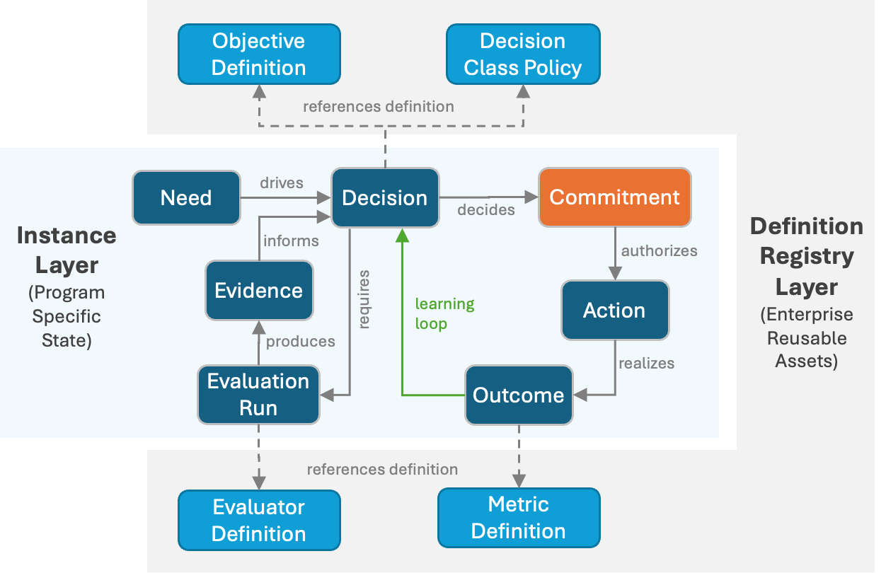
Schema makes decisions computable without product authority.
Typed graph semantics make dependencies, evidence, commitments, and learning loops queryable across lifecycle states.
Instance layer
Program‑specific state: Need, Decision, Evaluation Run, Evidence, Commitment, Action, Outcome.
Definition registry
Enterprise reusable semantics: Objective, Metric, Evaluator, Decision Class Policy.
Learning loop
Outcomes close the loop so future programs can reuse definitions and calibrate assumptions.
Why graph? Concept decisions are interdependent: Precedence, reuse, shared risk, common scenarios, and constrained resources.
Decision Digital Thread Schema Metamodel
Notes:
Defense: The original Figure 1 is used because it is the core contribution of the paper. The slide adds only three callouts to defend the design: instance state, enterprise definitions, and learning. This avoids drowning the audience in every node/edge while preserving the formal schema.
Presenter cue: Orient the audience: the center is program state; the outside is reusable enterprise semantics. That separation is why the schema scales beyond one case study.

Slide 8
Primitives' separate judgment, approval, execution, learning.
This separation is the schema’s audit defense: a good decision process can still have a bad outcome, so the record cannot collapse everything into one status field.
Need
Decision
Evaluation
Run
Evidence
Commit
Action
Outcome
trigger + scope
framing + options
execution provenance
reviewed basis
binding approval
authorized work
observed result
Decision quality
Approval quality
Execution quality
framing, alternatives, objectives, uncertainty
who committed, role, policy check, conditions
authorized actions, stop rules, realized outcomes
Key claim: DDT lets reviewers audit decision quality independent of whether later uncertainty produced a good or bad outcome.
Notes:
Defense: The deck needs a clean primitive chain separate from the full metamodel. This slide defends the structural separation requirement: Decision, Commitment, Action, and Outcome are not the same object. That is essential for post-hoc auditability.
Presenter cue: Make the philosophical point: hindsight outcome is not the same as decision process quality. The schema protects that distinction.

Slide 9
Audit‑grade semantics are invariants, not user guidance.
DDT is only credible if key semantics are mechanically enforceable. The paper turns governance expectations into object-level invariants.
01
02
03
04
Evaluation Runs
are immutable
Evidence has
trust state
Commitment is the
only binding event
Transitions are
governed events
Evaluator identity/version, inputs, referenced artifacts, and output hashes can only be superseded.
Readiness depends on reviewed/rejected status and reviewer roles, not merely file existence.
Approval captures approver role, rationale, conditions, and stop rules as constraints.
Every lifecycle change records actor, policy version, pass/fail, and blockers.
SEALED
REVIEWED
BOUND
CHECKED
Without invariants, DDT becomes another documentation convention.
With invariants, it becomes an audit‑grade decision system.
Notes:
Defense: This slide defends the strongest architectural choice in the paper: governance semantics are not suggestions. The four invariants map directly to the paper’s Section 4.1 and are necessary to reconstruct “what was known when.”
Presenter cue: Use this slide to separate serious enterprise governance from “we added metadata fields.” The immutability and transition records are the difference.

Slide 10
Registries turn local decisions into enterprise knowledge.
Stable, versioned definitions let programs compare decisions, reuse evaluators, and avoid semantic drift across toolchains.
Objective
definitions
Evaluator
definitions
Bias
playbooks
Definition
Registry
Program A
Decision
Program B
Decision
Metric
definitions
Alternative
blueprints
Program C
Decision
Controlled local overrides are allowed but must be explicit and justified — this is how reuse stays rigorous without killing program flexibility.
Notes:
Defense: The registry slide defends enterprise scalability. Without common objective, metric, evaluator, and bias-playbook definitions, each program creates a bespoke vocabulary and cross-program learning fails.
Presenter cue: Emphasize “local override with justification.” That phrase addresses the common objection that enterprise registries are too rigid for real programs.

Slide 11
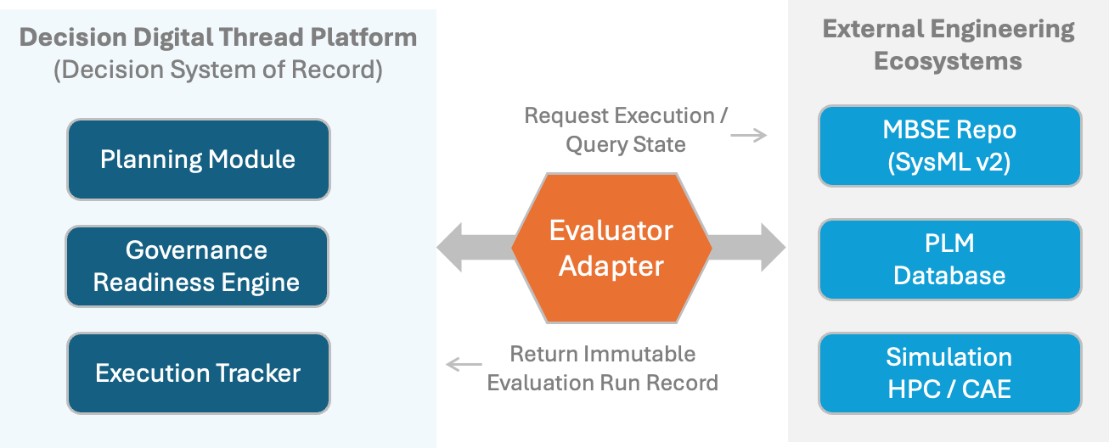
DDT is the Decision System of Record; Tools keep authority.
The architecture is federated: DDT governs decision state and provenance, while MBSE, PLM, simulation, test, and cost systems remain authoritative for their artifacts.
Operational Integration via Adapters
Formal interface
Adapter pattern
No side state
Planning, readiness, and execution modules read/write decision‑relevant state through the schema.
Evaluators request execution or query state; returned run records are immutable.
Workflow status, evidence review, policy checks, and lifecycle transitions belong in DDT.
Notes:
Defense: This slide addresses the architecture and adoption concern: DDT is not a mandate to replace MBSE, PLM, or simulation systems. It is a decision system of record that references authoritative artifacts and preserves the exact evidence-producing run record.
Presenter cue: Say: we are not trying to move every artifact into DDT. We are governing the decision-relevant state that currently leaks into side systems.

Slide 12
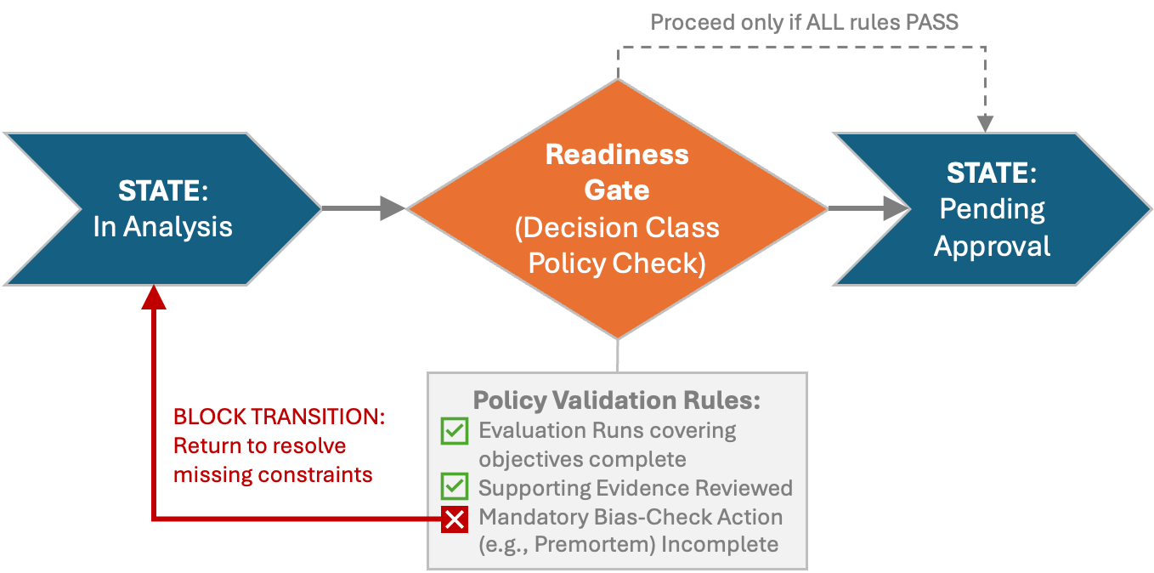
Readiness gates convert governance to executable controls.
Structural validation says, “the JSON is legal.” Readiness validation says, “this decision is not allowed to advance yet.”
Decision Class Policy checks
✓
Evaluation runs cover primary objectives
✓
Supporting evidence has required review status
✓
Stakeholders / approver roles are satisfied
✕
Mandatory bias-check evidence missing
Gate behavior: block transition, return explicit blockers, instantiate missing actions.
Policy-Driven Readiness Gating
This is where governance stops being narrative guidance.
Notes:
Defense: The readiness gate is the operational heart of the paper. The slide defends why a schema alone is insufficient: machine-readable policy must be evaluated against graph state before a decision can move forward.
Presenter cue: Contrast structural validation with readiness validation. The power is not in a pretty diagram; it is in the platform refusing a premature transition.

Slide 13
Agentic AI authority boundaries must be explicit.
DDT lets AI accelerate evidence work while preventing automation from creating implied commitments or bypassing lifecycle authority.
Agents may create / propose
Agents may not create / change
✓
Candidate alternatives
✕
Commitments
Readiness
Gate
✓
Evaluation runs
✕
Decision lifecycle state
✓
Evidence attachments
✕
Approval roles
✓
Draft actions
✕
Policy-check results
Principle: Agent outputs are first‑class artifacts, not authority. Human roles and policy gates still decide lifecycle transitions.
Notes:
Defense: This slide is essential for an AI-heavy conference audience. It avoids both extremes: no hand-waving AI autonomy, and no rejection of AI. The schema defines exactly which artifacts automation can produce and which governance-critical transitions remain role-constrained.
Presenter cue: Use the phrase “artifacts, not authority.” It is memorable and it makes the governance boundary intuitive.

Slide 14
Case: Range anxiety becomes a scoped concept decision.
The illustrative BEV pickup case demonstrates the schema on a realistic strategy decision while avoiding proprietary program data.
Need
MY2027 range anxiety mitigation under cold‑weather towing and high accessory loads
Scope boundary
INCLUDED
Select technology strategy and target operating envelope.
Decision
Question
Which range‑extension strategy best mitigates range anxiety while meeting cost and schedule constraints?
EXCLUDED
Detailed packaging, generator location, integration architecture, and calibration design.
TRIGGER
If generator strategy is selected, launch a narrower follow‑on integration decision.
The first governance move is not analysis. It is scope discipline.
Notes:
Defense: This slide defends why the case study begins with framing, not simulation. Scope boundaries are part of the decision artifact and prevent analysis drift. The included/excluded structure also shows how downstream decisions are triggered instead of being silently mixed into the current commitment.
Presenter cue: Stress that this is a fictitious but realistic case. The point is not the vehicle, it is the governable structure of a concept decision.

Slide 15
Trade space stays broad—but bounded and comparable.
Set‑based reasoning is preserved, but each option must connect to the same objective and metric definitions.
A1
Generator set
A2
Software‑only controls
A3
Increased battery capacity
Range extender; potential thermal support
Predictive energy management, thermal controls, driver guidance
Hardware energy increase and robustness across many duty cycles
Key governance risk:
Key governance risk:
Key governance risk:
Integration complexity, certification, NVH, customer acceptance
Performance bounds in worst‑case duty cycles; validation across variability
Mass, packaging, supplier readiness, cost/pricing pressure
Common objective definitions applied to all options
Range anxiety
Schedule feasibility
Development cost
Unit cost / pricing
Thermal contribution
The schema blocks false comparability: Different options can be evaluated differently,
but metric semantics stay stable.
Notes:
Defense: This slide defends the case alternatives and avoids an uncontrolled technical rabbit hole. The point is not to choose the best vehicle architecture in the presentation; it is to show that alternatives, objectives, metrics, and risks can be represented consistently and compared auditable.
Presenter cue: Tell the audience the trade space is intentionally bounded: enough to demonstrate set-based decision representation, not so much that the case becomes a vehicle design talk.

Slide 16
Evidence lineage is a reproducible run trail.
Every evaluation that informs a commitment must bind evaluator version, input bindings, scenario definitions, output artifacts, and sealing hashes.
Evaluator
Definition
Immutable
Evaluation Run
Reviewed
Evidence
EvaluationRun {
evaluatorDefinitionId: EVAL_ENERGY_THERMAL_RPC
evaluatorVersion: 1.2.0_certified
scenarioSetId: SCEN_USAGE_TEMP_TOW_V3
parameterBindings: [A1 genset kW, A3 pack kWh]
outputs: [results.parquet hash, summary.json hash]
evidenceIds: [EVD_ENERGY_THERMAL_0007]
sealedAt: 2026‑02‑01T16:25Z
runRecordHash: sha256:0f7c...3344
}
version
what code/model was used
inputs
exact parameter bindings
scenario
usage + temperature + towing set
hashes
tamper-evident output artifacts
seal
append-only provenance record
The run record does not copy model data. It captures the exact recipe that produced decision evidence.
The Immutable "Evaluation Run" Record (Provenance)
Notes:
Defense: This slide gives the technical audience a concrete data contract. It uses the Appendix B pattern but reduces it to the fields that matter on stage: evaluator version, inputs, scenario, hashes, evidence linkage, and sealing. This makes provenance tangible.
Presenter cue: Say: a current SysML URL is not enough. A future audit needs the exact run recipe and its sealed outputs.

Slide 17
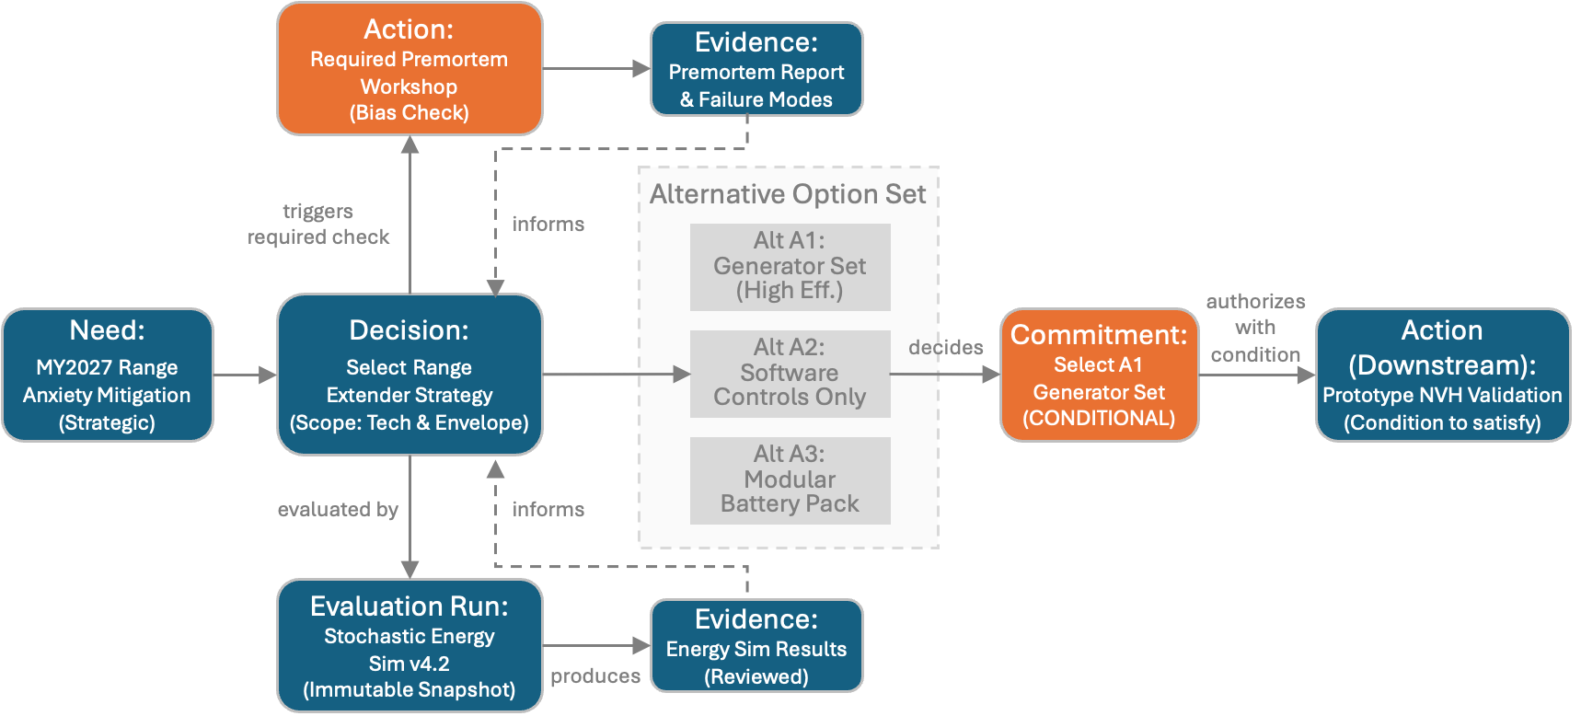
Gate walkthroughs are controlled.
The case shows DDT blocking an immature transition, instantiating missing work, and recording a conditional commitment with stop rules.
1
Decision in analysis
A1/A2/A3 option set and evaluation plan exist.
2
Gate fails
Premortem bias‑check action is missing reviewed evidence.
3
Planner instantiates action
Premortem workshop produces failure‑mode evidence.
4
Gate passes
Reviewed evidence and evaluator coverage satisfy policy.
5
Commitment is conditional
NVH/regulatory conditions and stop rules bind downstream work.
BEV Range Extension Concept Decision Instantiation
Conditional approvals become enforceable constraints, not informal to‑do notes.
Notes:
Defense: This slide defends the case study selection and the governance mechanics simultaneously. The gate fails first, which is important: it demonstrates enforcement, not just documentation. The conditional commitment shows how approvals remain machine-actionable downstream.
Presenter cue: Walk the left sequence slowly. The audience should understand that DDT creates blockers, not just records.

Slide 18
What becomes queryable after DDT.
The practical value is not the graph itself; it is the audit, governance, and learning questions the graph can answer months later.
Evidence
Which dataset and evaluator version justified A1?
Run
Decision
Audit
Queries
Which assumptions were valid at commitment time?
Commitment
Were required bias checks reviewed before approval?
Which conditions can void the commitment?
Action
What outcomes fed the learning loop for reuse?
Outcome
These questions are expensive when rationale is narrative; they are ordinary graph queries when DDT is the decision system of record.
Notes:
Defense: This slide translates architecture into value. It defends the content by showing the exact questions a chief engineer, program manager, auditor, or AI agent can ask after DDT has captured the decision state.
Presenter cue: Let the audience pick their favorite query. Each one maps to a pain point earlier in the talk.

Slide 19
Adoption Path: Govern without rebuilding every tool.
The schema can be introduced incrementally as a decision system of record layered over current MBSE, PLM, simulation, and document workflows.
1
2
3
4
Charter
decision classes
Build registries
+ adapters
Ingest legacy
rationale
Enforce gates
+ capture outcomes
Define lifecycle states, authority, readiness policy, bias checks.
Version objectives, metrics, evaluators, and connect native tools.
Import slides/minutes/reports with source provenance and human acceptance.
Block premature transitions and feed realized results back into reuse.
Adoption rule: Do not centralize all engineering data; centralize decision‑relevant state, provenance, and governance checks.
Notes:
Defense: This slide defends practicality. It acknowledges existing tool ecosystems and shows an incremental path rather than a disruptive replacement strategy. That is especially important for government and defense programs with heterogeneous authoritative systems.
Presenter cue: Emphasize the adoption rule. It is a crucial protection against the objection that DDT is “another massive data migration.”

Slide 20
Limitations — They define the validation agenda.
The paper does not claim the schema guarantees good decisions; it claims the schema makes decision quality assessable, auditable, and improvable.
What DDT does not claim
What to validate next
✕
It does not choose the best alternative by itself.
✓
Audit reconstruction time before vs. after DDT.
✕
It does not replace engineering judgment or validation.
✓
Rework and late gate blockers reduced through readiness policy.
✕
It does not fix poor adapter quality or teams that keep side state.
✓
Prediction vs. realization feedback improves evaluator calibration.
The schema enables quality control; empirical pilots quantify the impact.
Notes:
Defense: A world-class technical talk should not overclaim. This slide protects credibility by stating the boundary of the contribution and converting limitations into a research and deployment agenda.
Presenter cue: Say: DDT does not make humans wise; it makes the decision process visible enough to improve and audit.

Slide 21
A digital thread that represents products
but not decisions is incomplete.
Three takeaways
1. Treat decisions as first‑class governed objects.
2. Make evaluation provenance immutable and evidence review explicit.
3. Let AI accelerate analysis—but keep commitments and lifecycle transition's role‑governed.
From evidence → commitment → execution → learning
Questions / Discussion
DISTRIBUTION STATEMENT A. Approved for public release; distribution is unlimited. OPSEC#10865
Notes:
Defense: The closing slide returns to the central thesis and leaves the audience with three operationally actionable takeaways. It also avoids a weak “thank you” slide by restating the argument in memorable terms.
Presenter cue: Close with the sentence in the title. Then invite questions on implementation: readiness policy, adapters, AI boundaries, and case deployment.

